Slide 1
Copilot workshop, 1h
Chris Noring
Senior Advocate Microsoft

Slide 2
Agenda
What is Copilot
Quick overview
Modalities
How to think
Green field
Scaffold projects
Let’s build a game
Brown field
Add features, refactor, fix bugs etc
Wrap up
https://github.com/softchris/copilot-workshop

Slide 3
Install instructions
Install extension 1 and 2
Install Node.js
Install VS Code
https://github.com/softchris/copilot-workshop

Slide 4
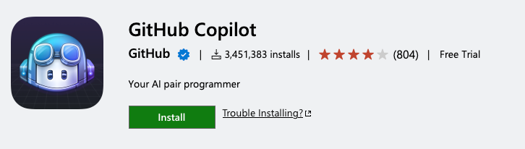
What is GitHub Copilot?
The brand name of GitHub’s AI for developers
Available for many editors and as an extension for VS Code
Currently powered by OpenAI’s Codex model
COST
10$ per month (first 2 months free)
Free for verified students, teachers, and maintainers of large open-source projects (link)
https://github.com/softchris/copilot-workshop
Notes:
GitHub already knows who the maintainers of big open-source projects are, and they will get a message that they qualify for free copilot when they go to activate it on their account.

Slide 5
Quick overview
GitHub Copilot is an AI assistant
You use prompts to generate text
Text can be code and/or docs
Two modalities, inline and chat
Features via Chat’s command menu, fix, test, describe, scaffold etc
https://github.com/softchris/copilot-workshop

Slide 6

Green field

Slide 7

GitHub Copilot, different modes of usage
Chat,
1
looks and works like ChatGPT
And has / commands, do for example scaffold projects
In-editor, you’re typing prompts in text files (e.g java,c#, javascript, markdown)
2

Slide 8
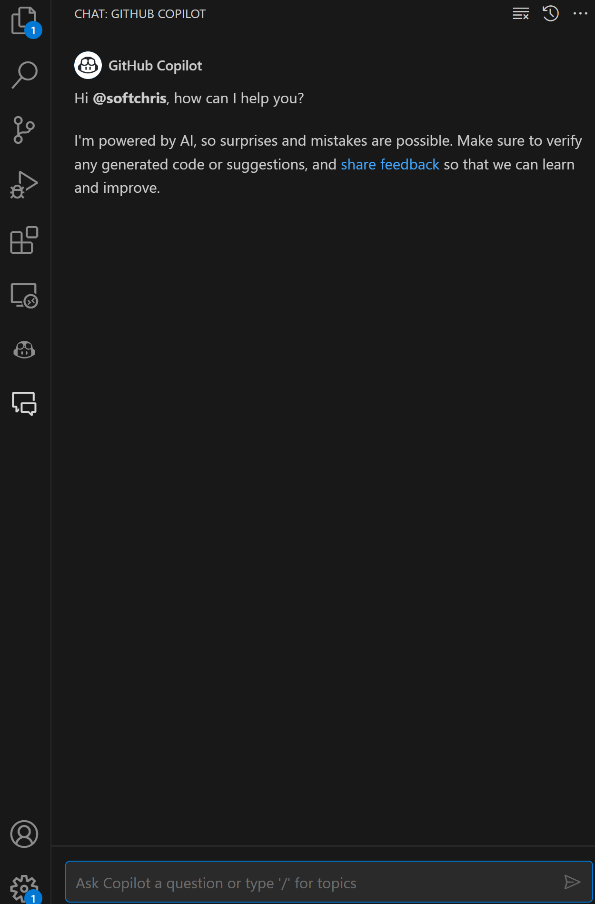
Copilot chat
Much like ChatGPT
Type what you want to do OR select a text and say what you want to do:

Slide 9
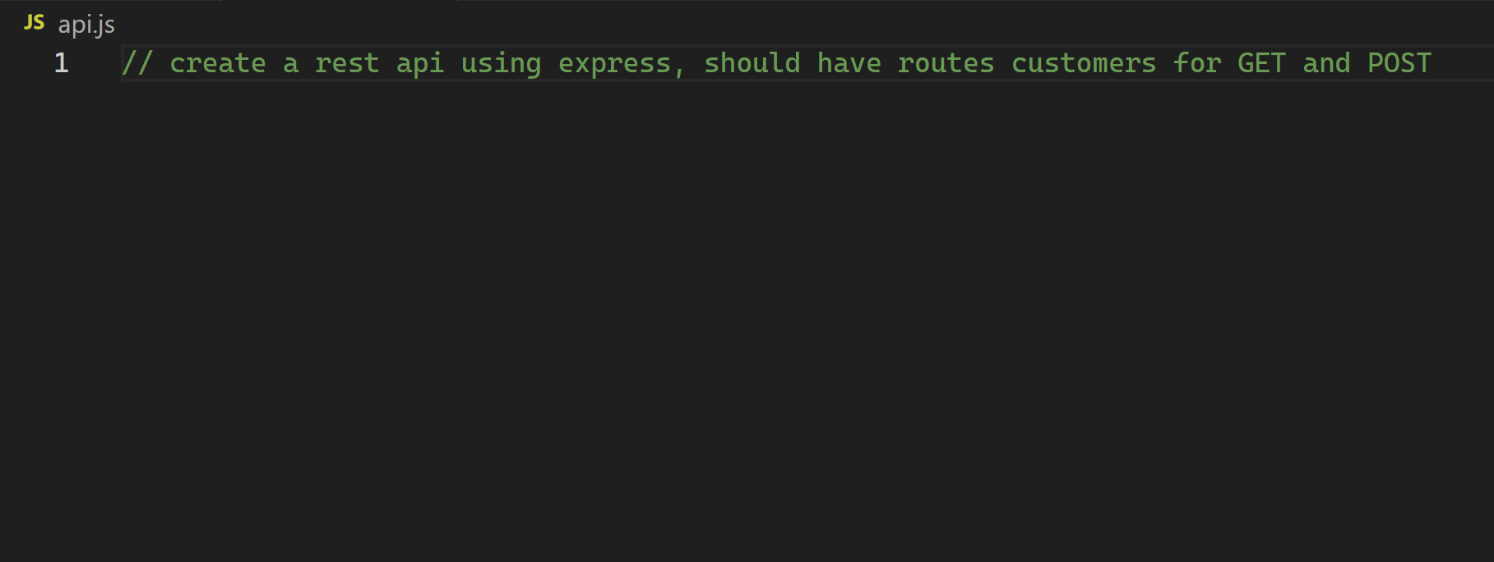
Copilot example, in-editor
Add a prompt as a comment
https://github.com/softchris/copilot-workshop

Slide 10
Green field our plan (using prompts)
1) "build a space game that contains a ship you control, should be a green rectangle, and 3 enemy fighters placed at the top of the screen. The screen is 800x600 pixels and uses a canvas element"
3) How can I detect collisions between the player's ship and the enemy fighters in the space game?
5) if player and enemy collide, display a game over message and reset the game
6) when a player presses space, it should shoot a laser from the top of the ship at high speed, if laser collides with enemy ship then laser and enemy should be destroyed. Laser should also have a cooldown so it can only be fired every 0.5 second
4) destroy player and enemy fighter if they collide
2)
make the player move, it should use the keys w a s d to do so
https://github.com/softchris/copilot-workshop

Slide 11
Green field plan cont.
7) show score at the top right of the screen. It should add 50 points every time a laser destroys an enemy
9) from the asset folder load images hero.png, enemy.png and laser.png async and draw those images instead of the rectangles
8) I add end condition, when there are no more enemies, should show, a text that say you won.. if text is clicked then game should reset
https://github.com/softchris/copilot-workshop

Slide 12
DEMO
See repo section “green field”
Let’s run the prompts

Slide 13
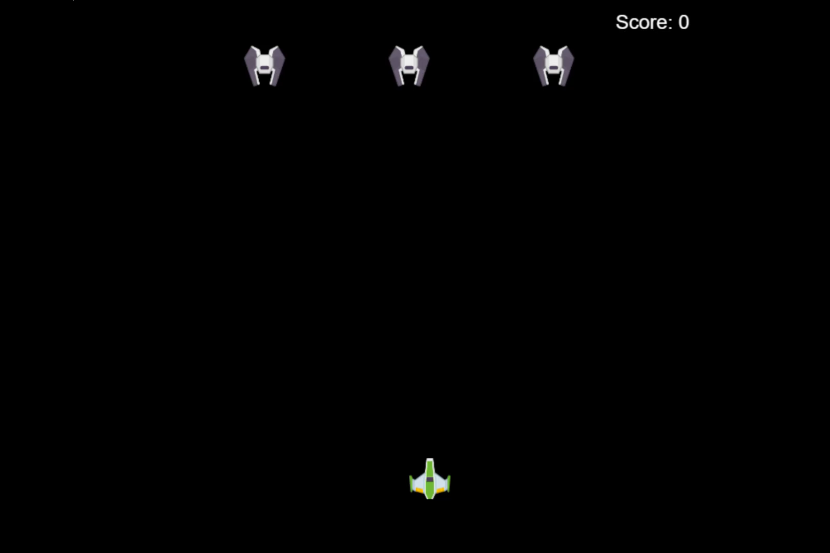
Final demo

Slide 14

Brownfield

Slide 15
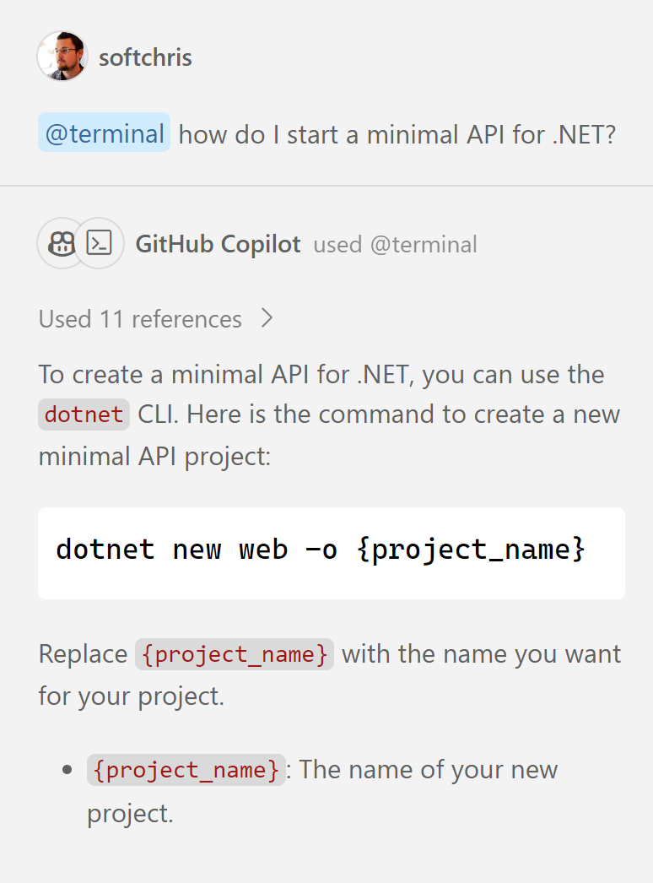
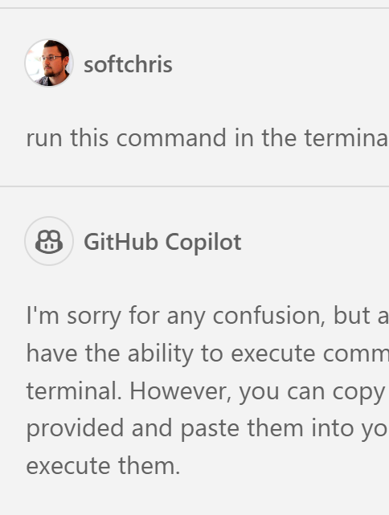
Feature: @terminal
Get help on how to do something in the terminal
Explicit prompts, "how do I start a minimal API project for .NET"
Context aware, "how do I run this project"
Limitations, can't run the command, need copy + paste
https://github.com/softchris/copilot-workshop

Slide 16
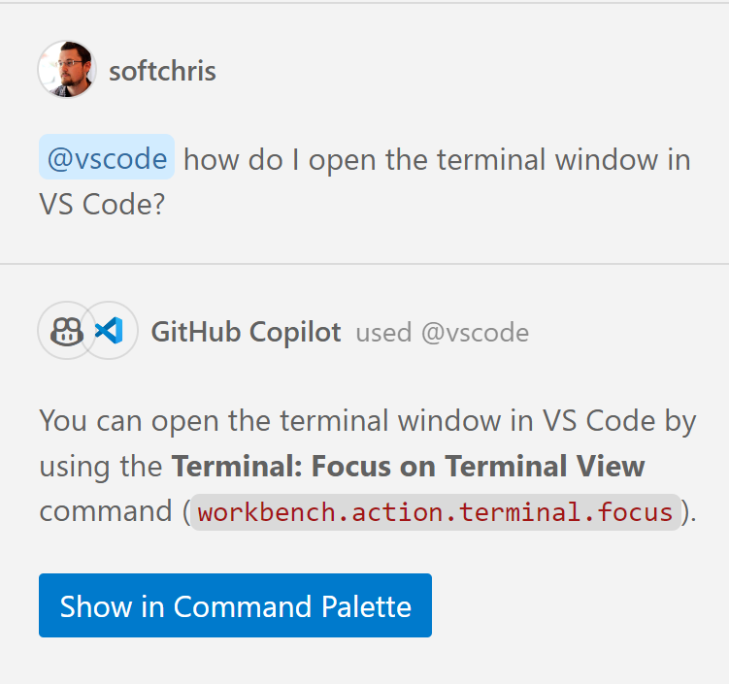
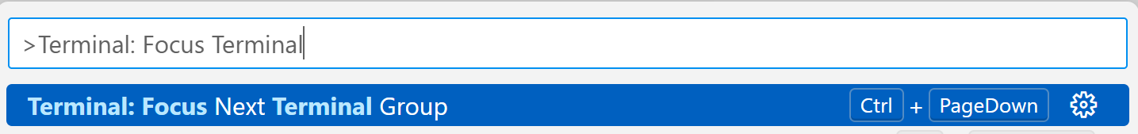
Feature: @vscode
Ask about how to do something in VS Code
Additionally offers a button for running the command
https://github.com/softchris/copilot-workshop

Slide 17
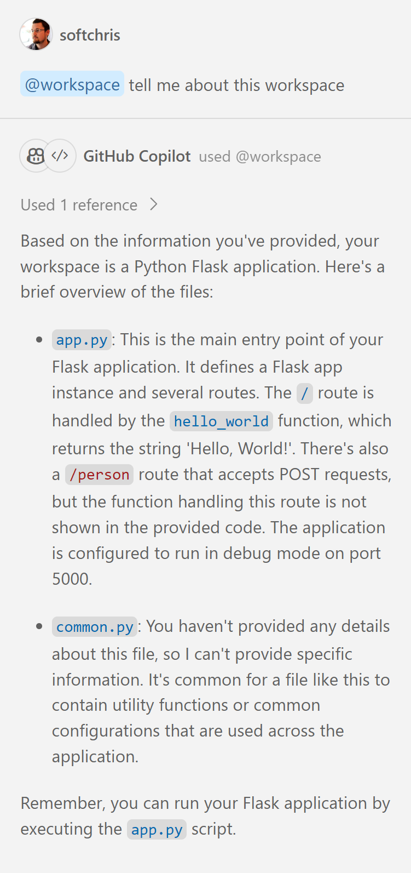
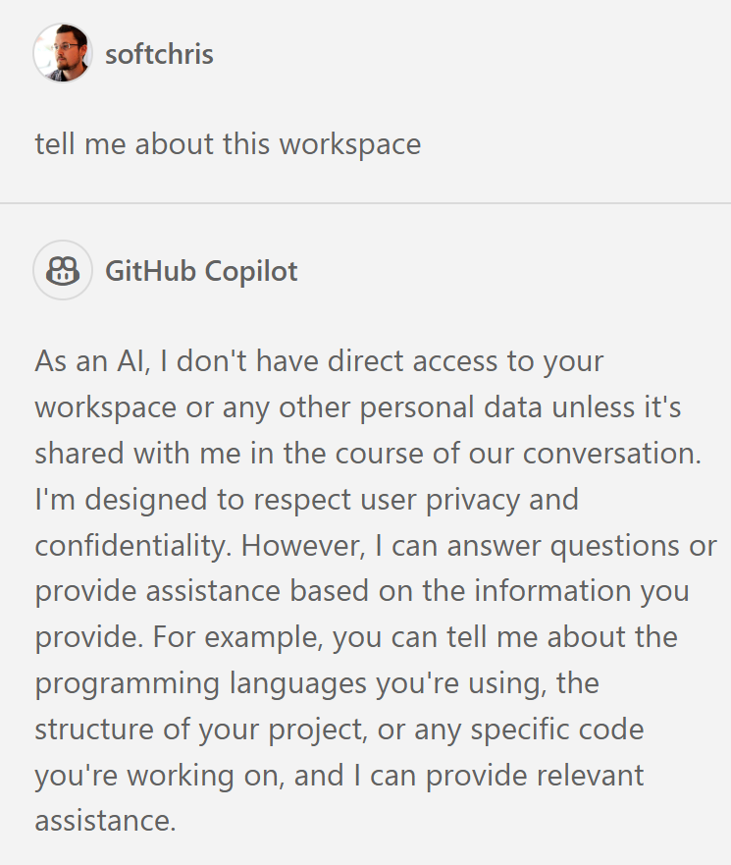
Feature: @workspace
Start with @workspace
Looks at your open directory
Look up project info, files, file content
Use cases:
Run build, test project
Add code depending on existing code
https://github.com/softchris/copilot-workshop

Slide 18
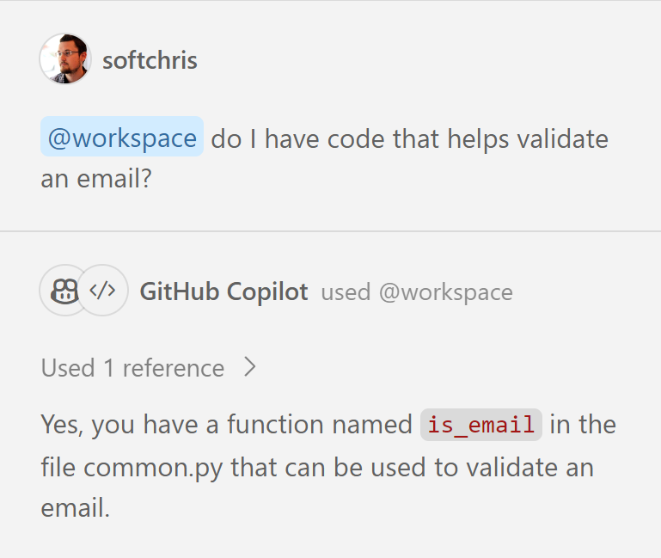
Feature: @workspace
With workspace
Ask about your workspace
Act based on new info
https://github.com/softchris/copilot-workshop

Slide 19
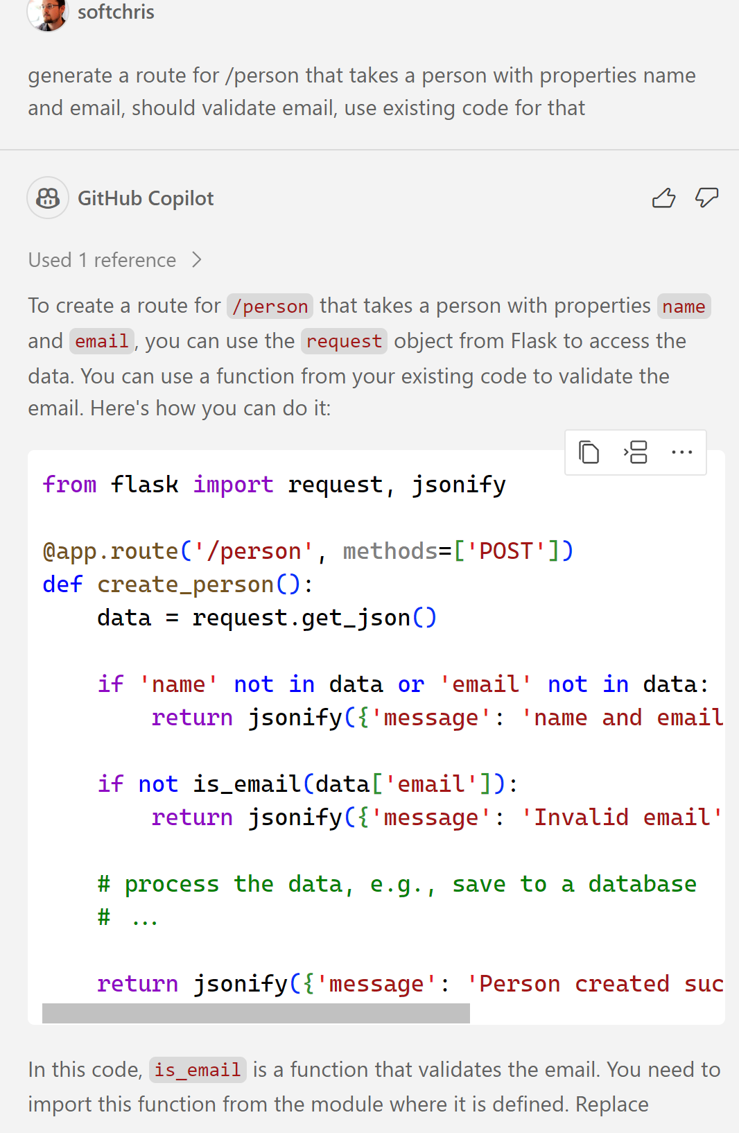
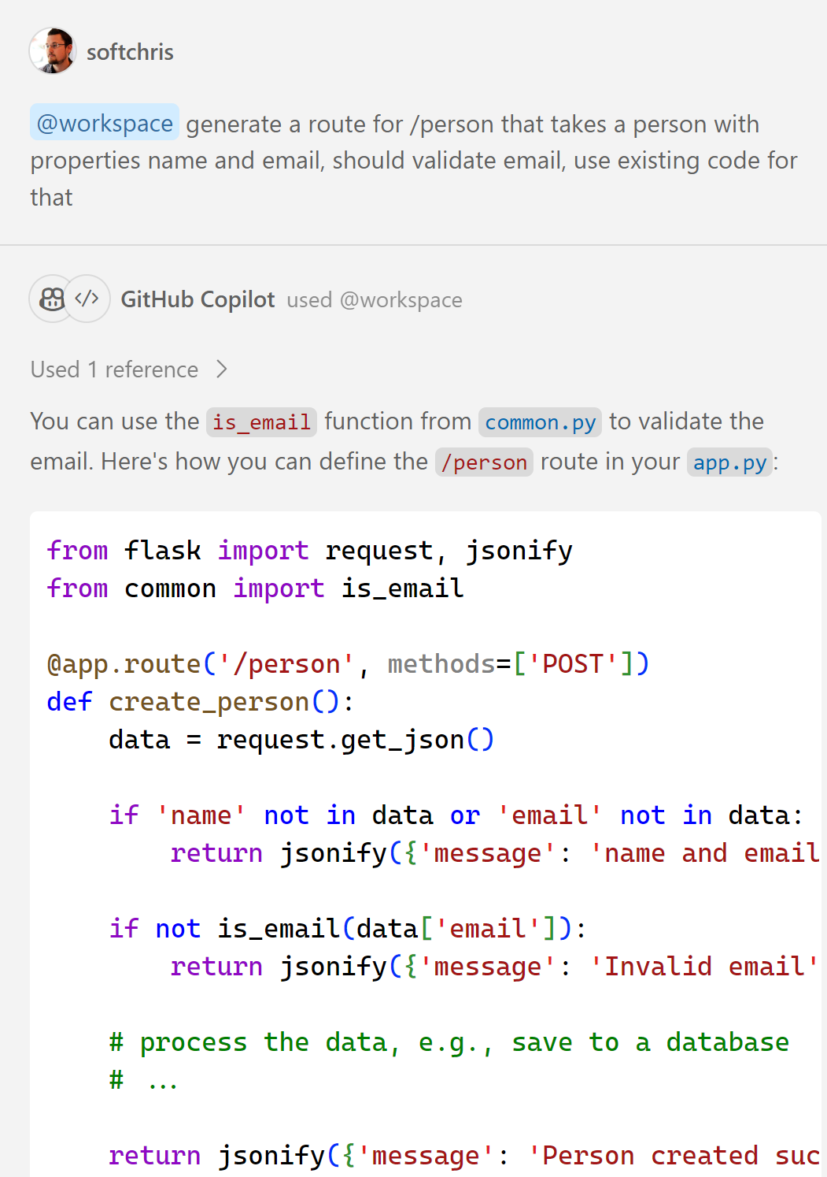
Feature @workspace, example
Use code from the workspace
https://github.com/softchris/copilot-workshop

Slide 20
Brownfield Our plan (using prompts)
1) improve the code, ensure laser, player and enemy are made into classes etc
4) Add meteors, there should be 3 meteors, they should move from the top of the screen to the bottom. If a player or enemy collides with it, they should both be destroyed. Meteors has an image asset meteor.png that should be used to render it. Meteors can be destroyed by a laser and the player should be awarded 20 points for each meteor destroyed
6) when the game ends due to a player colliding with a meteor, it visually doesn't reset the game, can you tell me what the problem is?
2) improve this code further, use a game class and add appropriate methods in there"
7) how can I improve the performance in this code?
8) how can I user performance profiling in Chrome
3) use above class and update the entire code file to use it
5) make the meteors move randomly with in the screen and at different speeds
https://github.com/softchris/copilot-workshop

Slide 21
DEMO: Let’s go to our repo
Test the prompts
Run solution

Slide 22
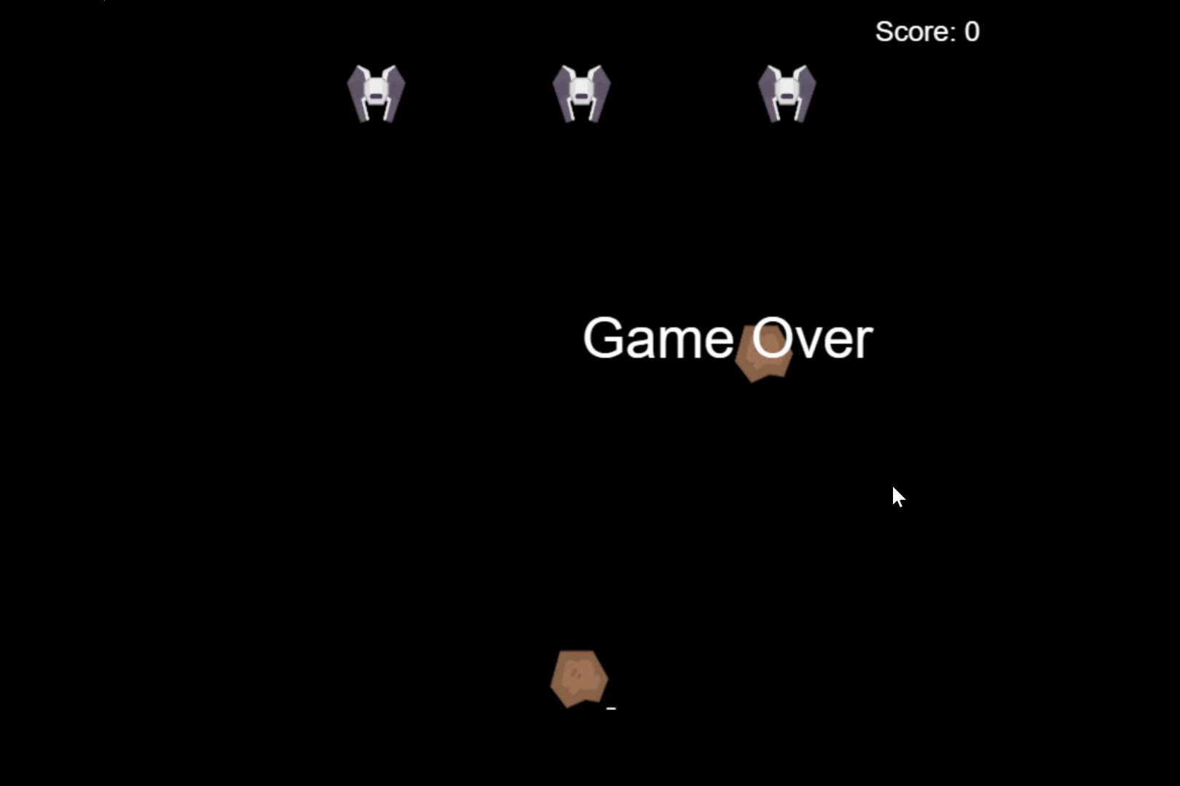

Slide 23
CLI, command line interface how can we manage our projects
Run the game
Install dependencies
Run tests
Build the game
Deploy the game
https://github.com/softchris/copilot-workshop

Slide 24
CLI our plan
4) @terminal how can I run tests for this project?
8) @workspace, make it so the enemy fighters are firing a green laser at the player, for every laser that hits the player, the player should lose a life, players starts with 3 lives. Laser image is called green-laser.png
1) how do I run this project?
5) split upp app.js in separate files, use es6 modules, also suggest bundler and bundler configuration
2) how do I set up my project so I can install dependencies for running tests?
6) how do I install and run webpack
3) can you suggest some suitable tests for this project? and create them using jest
7) Explain: Cannot use import statement outside a module, using jest
https://github.com/softchris/copilot-workshop

Slide 25

DEMO
Go to 06 CLI folder
Test the prompts

Slide 26
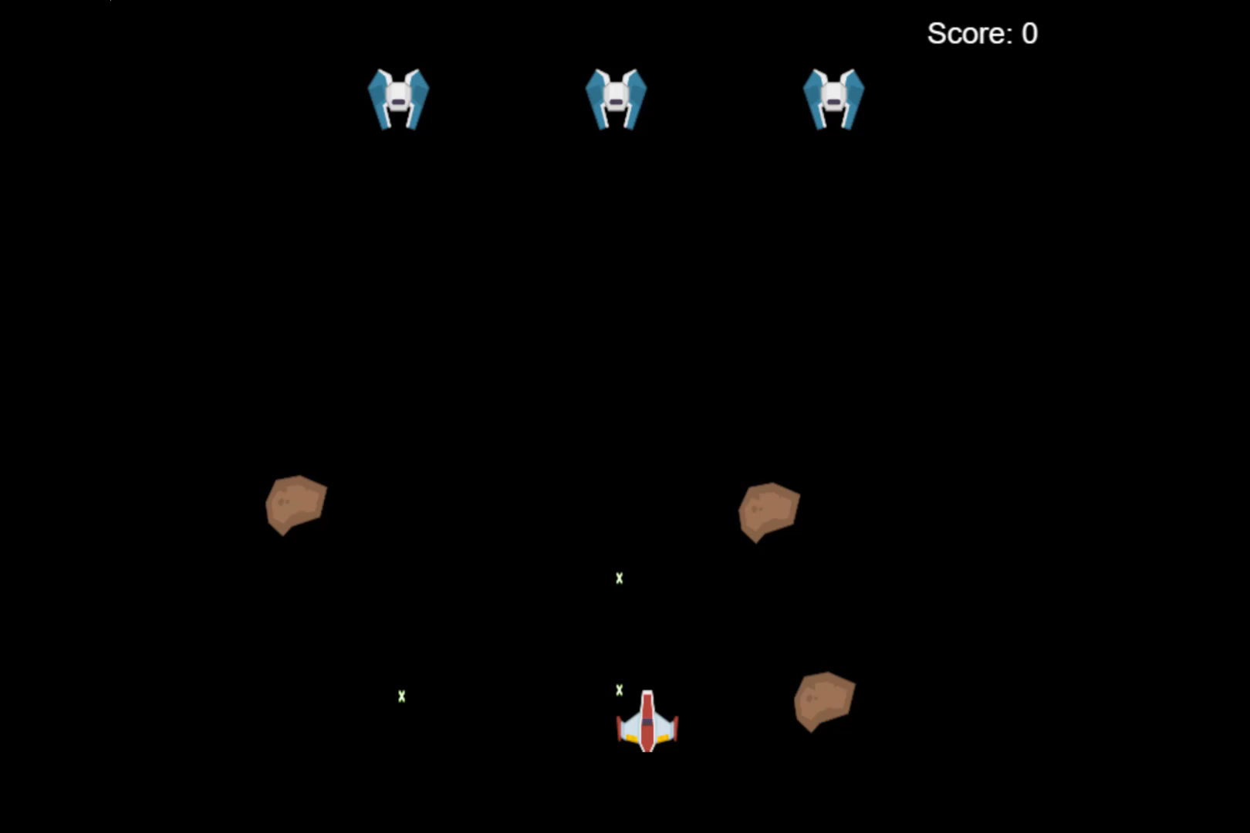

Slide 27
Summary
Learning resources
https://aka.ms/copilot-learn
https://aka.ms/copilot-videos
https://aka.ms/copilot-youtube
https://github.com/softchris/copilot-workshop

